Slide 1
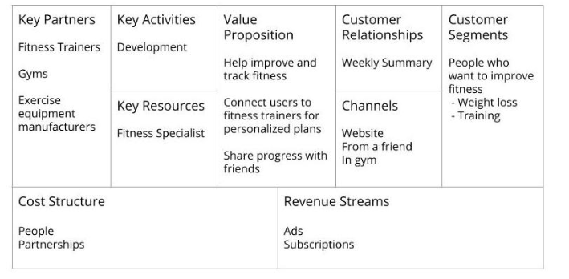
Notes:
EXAMPLE** Fitness App

Slide 2
Business Model Canvas
Key Partners • Software developers • Payment Processors | Key Activities • App Development • Sales and Support | Value Proposition • Easily track fitness goals and progress • Encourage fitness and make it easy to start |  | Customer Relationships • App store reviews | Customer Segments • Busy working adults • Young adults/ Students • Elderly • Anyone who wants to be fit and start easily
 | Key Resources • Data Centers • Algorithm that encourages use and goal setting |  |  | Channels • App Stores • Referrals
Cost Structure • People • Data Centers |  |  | Revenue Streams • Subscriptions • Free with ads
Notes:
*Practice: Fitness App

Slide 3
Business Model Canvas
Key Partners •Hilton property partners who participate in the rewards program for users • Businesses^ | Key Activities • Software development to add the additional features to the existing app | Value Proposition • Help users plan and enjoy their trips seamlessly • Allow users to book activities in the app as well as see what activities are available (personal recs) • Allow users to order room service and make reservations easy |  | Customer Relationships • Survey after each trip | Customer Segments • People who want to take the stress and inconvenience out of travel – like business trips
 | Key Resources • A travel agency/ planner to help us understand traveler’s needs |  |  | Channels • From a friend or colleague • Hilton website • App Store
Cost Structure • People • Partnerships |  |  | Revenue Streams • Subscription • Bookings (free model – earn on concierge)
Notes:
*Practice: Hilton Honors

